Slide 1
Intro to FTC Code
Don’t panic!
https://github.com/JimWright4089/FIRSTWorkshops

Slide 2
Intro
Things covered in this class:
Setting up the phones
Block Programming
OnBot Java

Slide 3
Setting up the phones
You need two phones
One to be the Robot Controller, Google Play has the FTC Robot Controller tool.
One to be the Drivers Station. Google Play also has that tools.
https://github.com/JimWright4089/FIRSTWorkshops

Slide 4
Phones
Check the rules for which ones:
ZTE Speed
Google Nexus 5
Samsung Galaxy S5
Motorola Moto G 2nd Generation / 3rd Generation
Motorola Moto G4 Play
Motorola Moto G5 (Plus)
Motorola Moto E4 (USA versions only, includes SKUs XT1765, XT1765PP, XT1766, and XT1767)
Motorola Moto E5 (includes XT1920 and XT1925)
https://github.com/JimWright4089/FIRSTWorkshops

Slide 5
Controller in test
Rev Robotics who makes the Expansion Hub also makes a Control Hub.
This Control Hub is being tested this year at various locations
Hopefully, next year it will be available to us.
It would take place of one of the Hubs,
https://github.com/JimWright4089/FIRSTWorkshops

Slide 6
Setting up the phones
Under the settings you will find tools to set the names of the phones.
<team number>-DS for Driver station
<team number>-RC for Robot Controller
Spare phones user letters between the team number and the –XX. Like 4444-B-RC

Slide 7
Setting up the phones
Connect the Driver station to a joystick, or hub with two joysticks connected to it, through a OTG cable.
Connect the Robot Controller to the Robot through a Mini B to Micro B cable.

Slide 8
Setting up the phones
The Robot controller needs a Robot Configuration to run.
When you name things in the configuration, you must use those names in the programs.

Slide 9
Programming
You have a bunch of ways to program your robot.
Block
OnBot
Andriod Studio

Slide 10
Block and OnBot connection.
You will enable another WIFI connection to the Robot Controller
Use the Program and Manage menu item.
From this panel you will see the WIFI name and WIFI key for the robot controller

Slide 11
Block and OnBot connection.
You will enable another WIFI connection to the Robot Controller
Use the Program and Manage menu item.
From this panel you will see the WIFI name and WIFI key for the robot controller.
Point your browser to the IP address on the RC. Something like:
http://192.168.49.1:8080

Slide 12
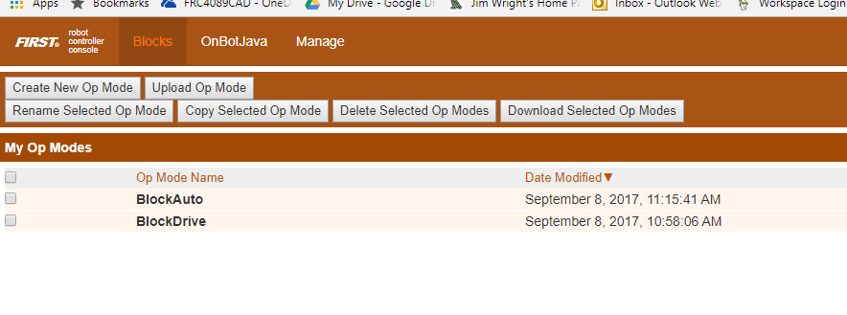
Block
Screen:

Slide 13
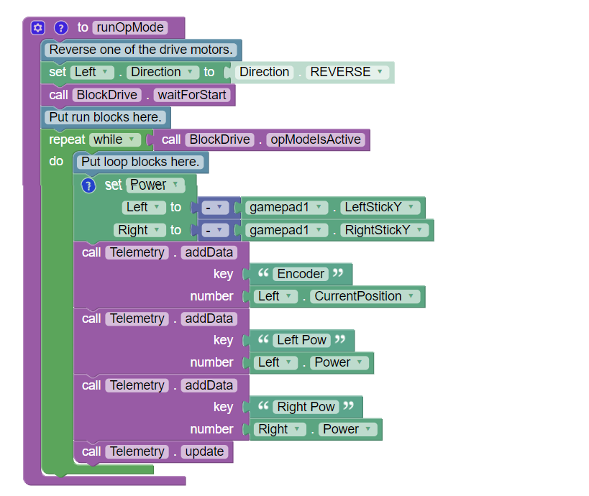
Block

Slide 14
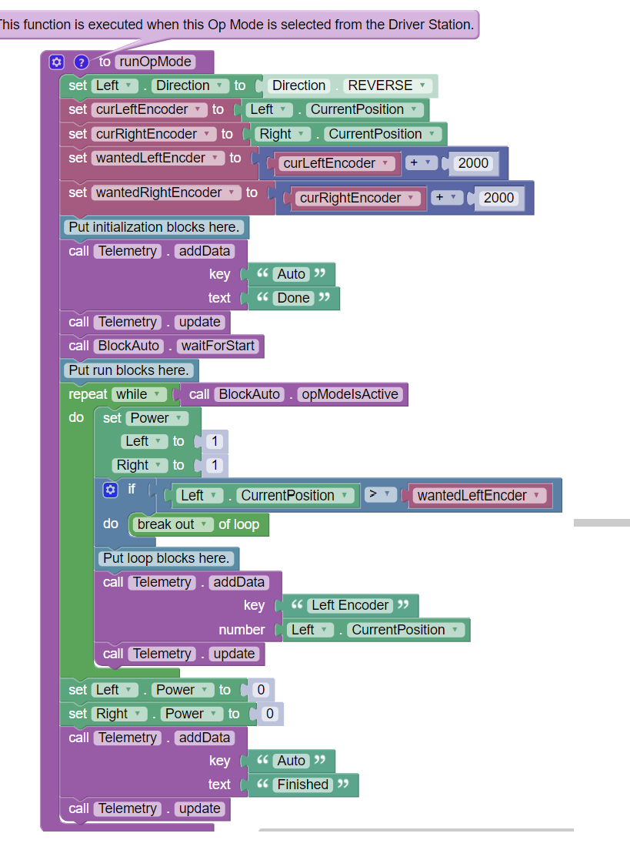
Block

Slide 15
OnBot
Standard Java, just on the robot!

Slide 16
OnBot
rightMotor = hardwareMap.dcMotor.get("Right");
rightMotor.setDirection(DcMotor.Direction.REVERSE);// Set to FORWARD if using AndyMark motors
rightMotor.setMode(DcMotor.RunMode.STOP_AND_RESET_ENCODER);
rightMotor.setMode(DcMotor.RunMode.RUN_WITHOUT_ENCODER);
waitForStart();
runtime.reset();

Slide 17
OnBot
while (opModeIsActive()) {
Integer rightEnc = rightMotor.getCurrentPosition();
telemetry.addData("Status", "Run Time: " + runtime.toString());
telemetry.addData("R Enocder", rightEnc.toString());
telemetry.update();
leftMotor.setPower(-gamepad1.left_stick_y);
rightMotor.setPower(-gamepad1.right_stick_y);

Slide 18
Andriod Studio
A lot more complicated than OnBoard Java
A lot more flexible as well.
A good tool to know

Slide 19
Android Studio Setup
Download/Install JDK
Download/Install Android Studio
Get FTC project (next screen)
Import the FTC project.
Hit yes to installing all of the tools and updates Android Studio needs

Slide 20
FTC Project
Github has it.
https://github.com/ftctechnh/ftc_app
You can download and use it from Github.
Better to fork the code into your Github project. This lets your team check in code,

